Slide 1
Digital Twin Technology
Presented By
Prithviraj Patil
1JS19CS125
Guide
K V Shanthala
Assistant Professor
Dept of CSE, JSSATE

Slide 2
Introduction
In recent years, Digital Twins (DT) have been implemented in different industrial sectors, in several applications areas such as design, production, manufacturing, and maintenance.
They are used for enhancing performance and reducing operating cost, offer the business including increased reliability of equipment and production lines
Technologies including Artificial Intelligence, Machine Learning, Deep Learning, IoT, sensor, simulation, connectivity and big data have led to sophisticated digital twins.

Slide 3
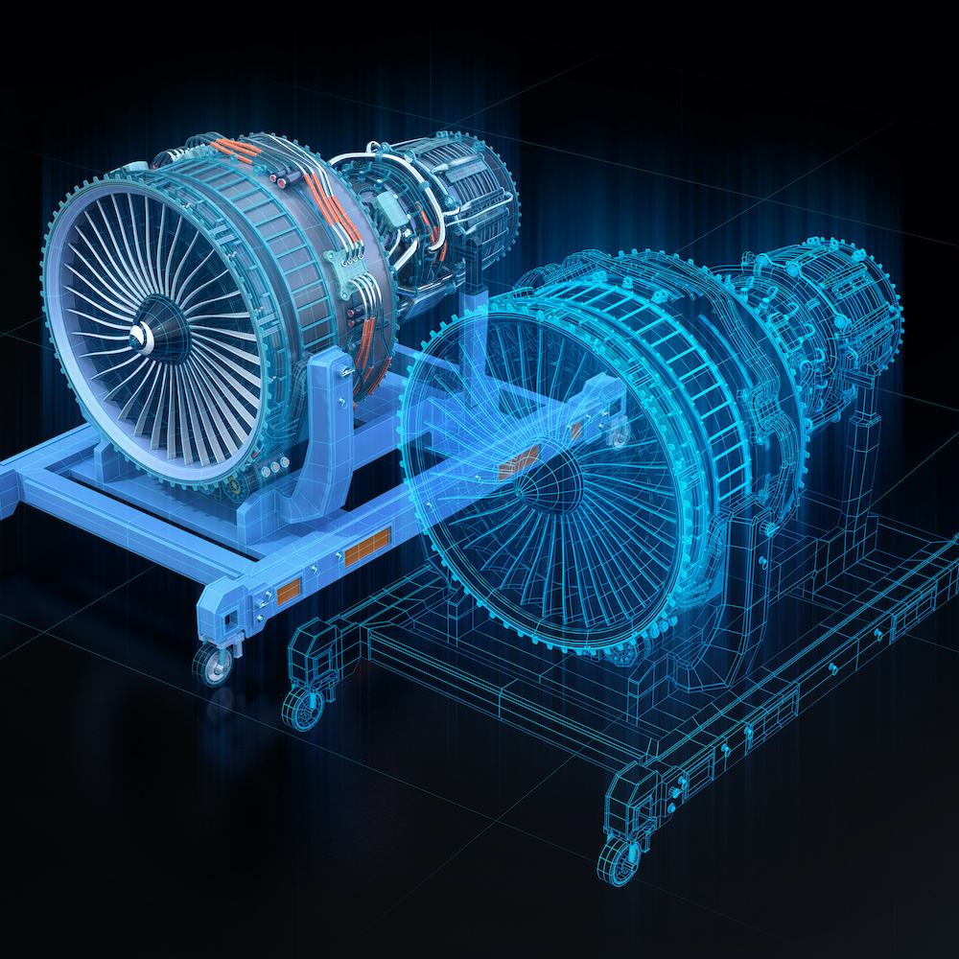
What is Digital Twin?
A digital twin is defined as a virtual representation of a physical thing.
The sensors connected to these physical assets collect data that is mapped onto the virtual model.
Digital twin enables people to see vital
information about how the physical thing
operates in the real world.

Slide 4
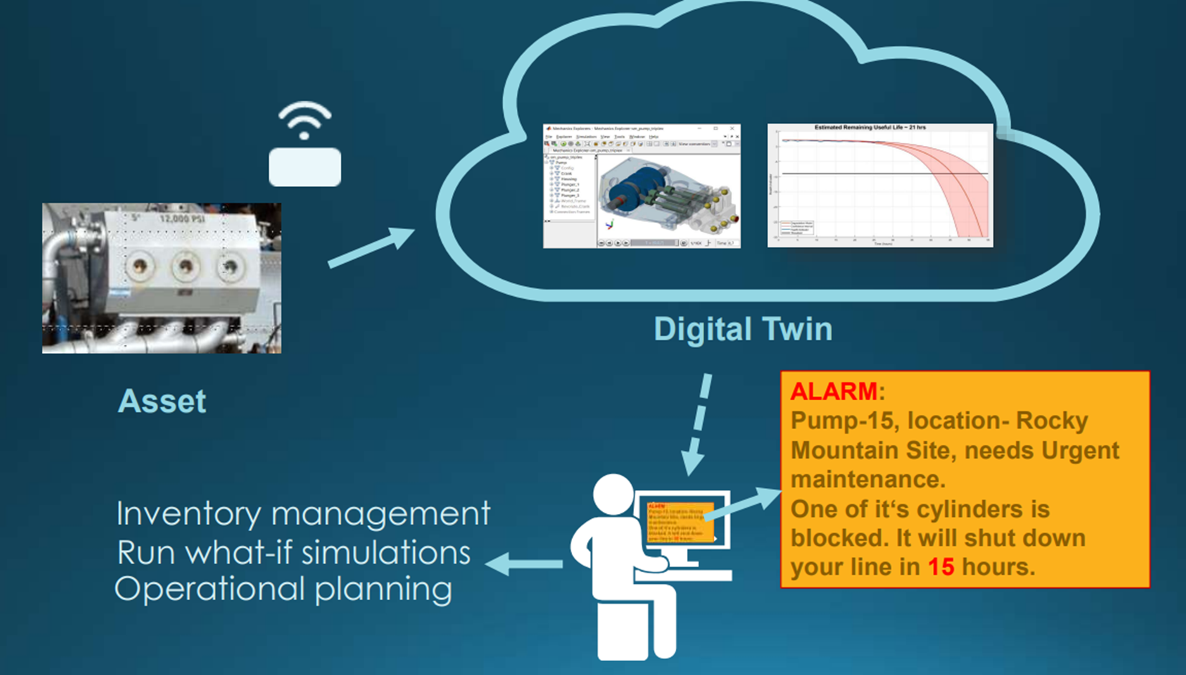
A digital twin is an up-to-date representation of a real asset in operation.

Slide 5
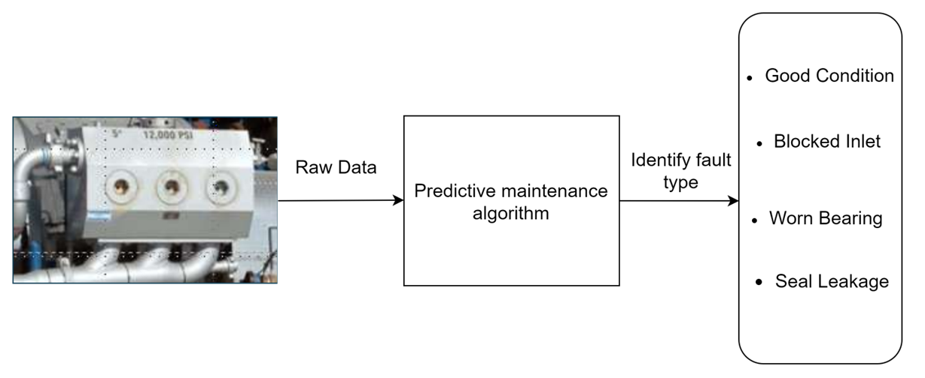
Use case – Fault classification of a pump
Objective:
Using machine data to determine what needs to be fixed
Solution:
Develop predictive Maintenance Algorithm

Slide 6
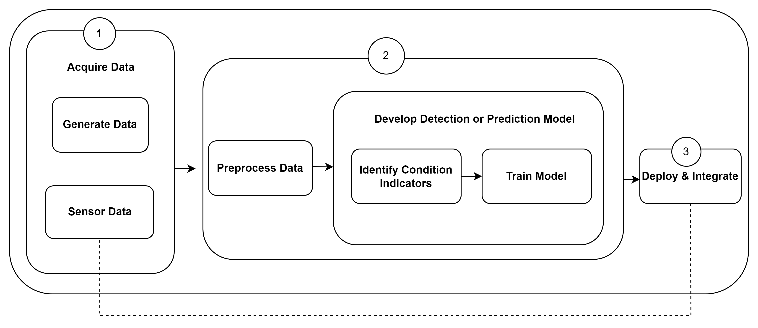
Approach

Slide 7
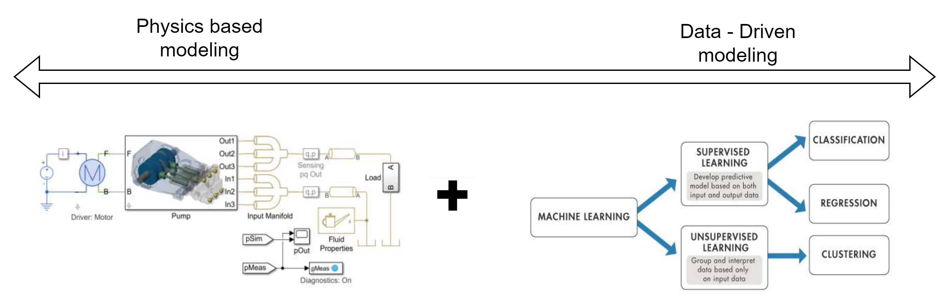
Capture Physics Captures behaviour using sensors

Slide 8
ALGORITHM
Digital twin technology is the development of advanced ML algorithms \ neural network that can be readily used to update the model and make future predictions
Derivative generalization method
Principal Component Analysis (PCA) In the context of Machine Learning (ML), PCA is an unsupervised machine learning algorithm that is used for dimensionality reduction.

Slide 9
Applications of Digital Twin
Performance tuning
Digital Machine building
Healthcare
Smart Cities
Digital Twin examples in practice
Digital Twin technology on city infrastructure: To improve the transportation and travel systems in New York City, the government decided to build a digital replica of the city itself. Having data on the average deterioration rate of a road in one of the busiest streets of the city, they are able to make safe predictions.
Digital Twin is used for aerospace engine monitoring: By creating a digital twin of an aircraft’s engine, pilots will have the ability to monitor engine health and progress the simulation 10 hours at a time (during a flight) in order to see if the potential risk of the engine experiencing a fatal failure in the near future
Digital Twin is used in the germany rail network in NVIDIA Omniverse

Slide 10
ADVANTAGES
Performance monitoring
Improved productivity
Increased reliability
Performance tuning
DISADVANTAGES
Compatibility challenges
Inconsistencies
Handling data
Security

Slide 11
Conclusion
The growth in Digital Twin use has seen a shift in recent Years It would not be possible without the same growth in the AI and IoT ﬁelds, which are becoming key enablers for Digital Twins
Digital twin technology combined with the latest machine learning and artificial intelligence tools is helping companies across many industries reduce operational costs, increase productivity, improve performance, and change the way predictive maintenance is done. For product manufacturers.
Digital twin technology is helping us to achieving more efficient production lines and faster time-to-market.

Slide 12
Future Scope of Digital Twin
As more companies use digital twins to build products, they can start building up entire ecosystems. Products can react in a virtual environment, giving real-time data to help develop future internet of things (IoT) products and more.
Sectors that benefits from Digital twin technology are aerospace, defence, heavy machinery, automotive, consumer goods and electronic’s, power & energy etc.
As per estimates, the market for digital twin is set to grow at a rate of more than 30% per year from 2020 till 2025 as an increase in demand for IoT and cloud-based platforms.
We predicted that by 2023, over two-thirds of companies that have implemented loT will have deployed at least one digital twin in production. We might actually reach that number within a year. - Gartner

Slide 13
THANK YOU

